Slide 1






Secure Coding
Vulnerability scanner for Node.js
Team Members
Sridharan S
Srish N
Vigneswaran S

Slide 2


Objective
To develop a comprehensive vulnerability scanning tool focusing on Node js applications and CVE-ID-based vulnerability discovery in them , enabling proactive identification and remediation of security weaknesses.

Slide 3

Problem Description
Existing traditional security measures are often inadequate in combating modern cyber threats.
Node js being a server side application it is vulnerable to attcks like prototype pollution,SQL injection etc.
Problem Statement
To develop a vulnerability scanning web appllication using Django capable of identifying a wide range of security vulnerabilities in Node js app and provide users with detailed reports and effective mitigation actions.

Slide 4

Problem Solution
We propose a static vulnerability analyzer tool which will analyze the vulnerability in the given code and report will be generated for it.
We will be using keyword matching, syntax checking, threat modelling using NVD and CVE's to analyze the node js application and find the vulnerabilities.
The report will be emailed to the client. The report will contain the mitigations user can approach.

Slide 5
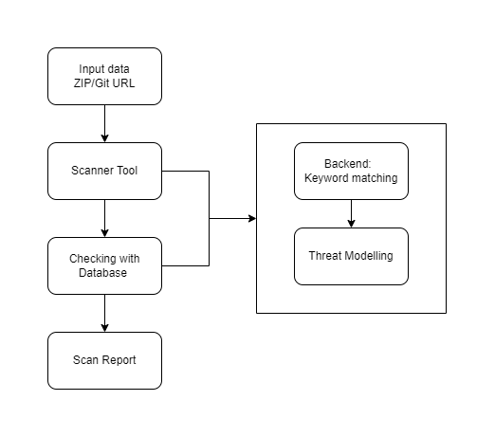
Block Diagram

Slide 6
Reference
1.Code-based vulnerability detection in Node.js applications: how far are we?
Bodin Chinthanet, Serana Elisa Ponta, Raula Gaikovina Kula, Takashi Ishio.
2.Scaling JavaScript Abstract Interpretation to Detect and Exploit Node.js
Taint-style Vulnerability - Mingqing Kang, Yichao Xu, Song Liy, Rigel Gjomemoz,
Jianwei Hou, V.N. Venkatakrishnan, and Yinzhi Cao.
3.On the Discoverability of npm Vulnerabilities in Node.js
Projects - MAHMOUD ALFADEL, DIEGO ELIAS COSTA, and EMAD SHIHAB.

Slide 7
Thank You
Our project code is in the following Github Repository:
https://github.com/srish-cell/VulnScan/tree/main

